Slide 1


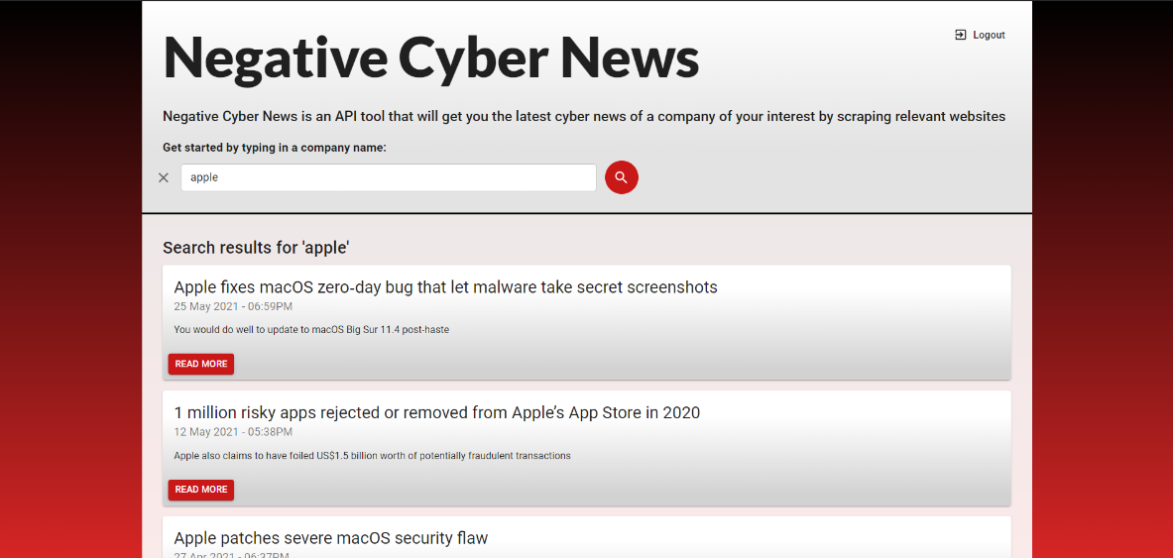





הפקולטה למדעים
מערך פרויקטים ושיתוף פעולה עם התעשייה
Cyber/ Web Application Computer Science Faculty | Negative Cyber News Hosted by Roi Zimon Niv Amos (316464486), Roy Aboudi (315976415), Matan Zofi (312539539)
Introduction
Negative cyber news is a website that it’s goal is to present reports/articles about recent cyber attacks on companies. The application includes a search engine in which the client is able to type in a company name and submit a request. Our API will then scrape the web and withdraw relevant recent articles concerning cyber attacks that occurred to that company. In order to make a use of the application, one must authenticate.
The end product of the project mostly did meet our expectations; therefore, we consider the project as a success.
Fully implemented user registration and authentication features, with database that stores the users' credentials.
Fast search engine that shows the latest and most relevant results.
Modern design to the website.
Fully implemented error handling and error presentation to the user.
Complete separation between client and server.
Conclusions
Discussions
An additional improvement possible for the application is to scrape a website or twitter page that displays the latest CVEs once a day and displaying them in the web in a new route.
Adding features that include machine learning to improve the search function.
Adding score to each result that indicates its credibility.
Methodology
The cyber-attacks reports are collected from credible resources involved in the cyber industry, in the role of open-source intelligence. Each resource that is being used has been tested and chosen because it has the most recent and reliable reports.
The web application contains several parts: the server-side will handle authentication, authorization and user’s search requests. The database (MongoDB) stores the registered users. Moreover, it manages the scripts that are responsible for the web-scraping. These scripts are written in Python. The client-side was built in React and it includes a modern UI. The articles will be presented to the user once a search is being committed.

